Slide 1
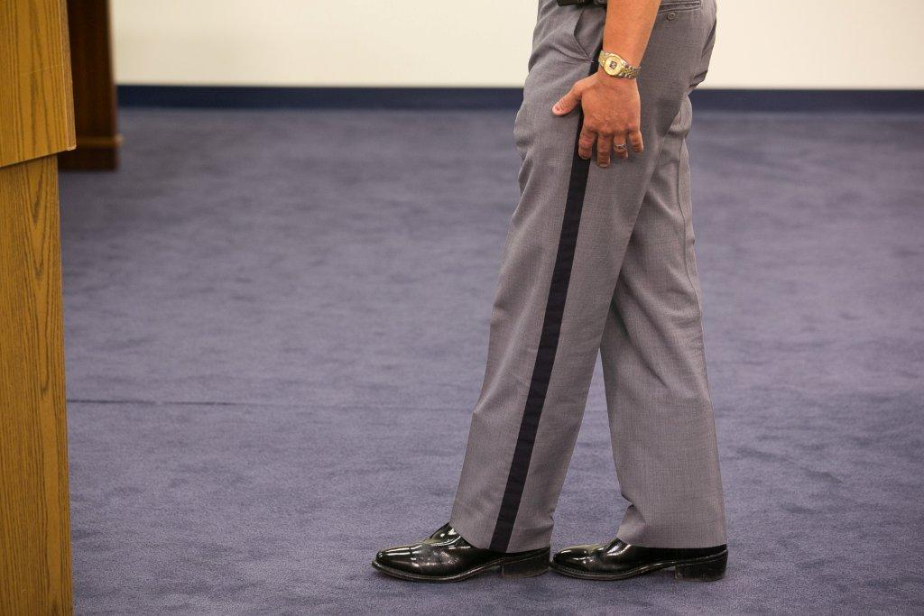



Session 13-A
Dry Lab

Slide 2

Learning Objectives
Properly administer SFSTs
Properly observe and record subject’s performance utilizing field note-taking guide
Properly interpret subject’s performance
Properly use and maintain SFST Log

Slide 3
Procedures
Same teams as dry run
Each subject will be viewed performing all three tasks
Only one opportunity to view each subject
Record number of clues observed in appropriate boxes on video recording worksheet

Slide 4
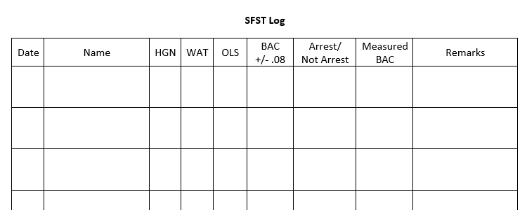
SFST Log

Slide 5
Questions?

